Slide 1
NOTHING
FAILS
LIKE
SUCCESS
Eduardo Ruah
Bologna April 2019

Slide 2
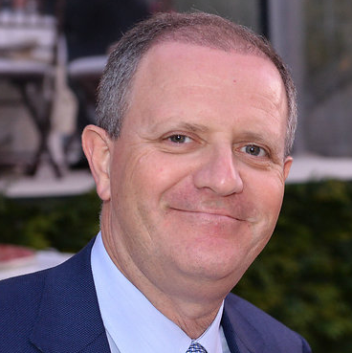
EDUARDO RUAH
France
Switzerland
Portugal
Hong Kong
Angola
Brazil

Slide 3
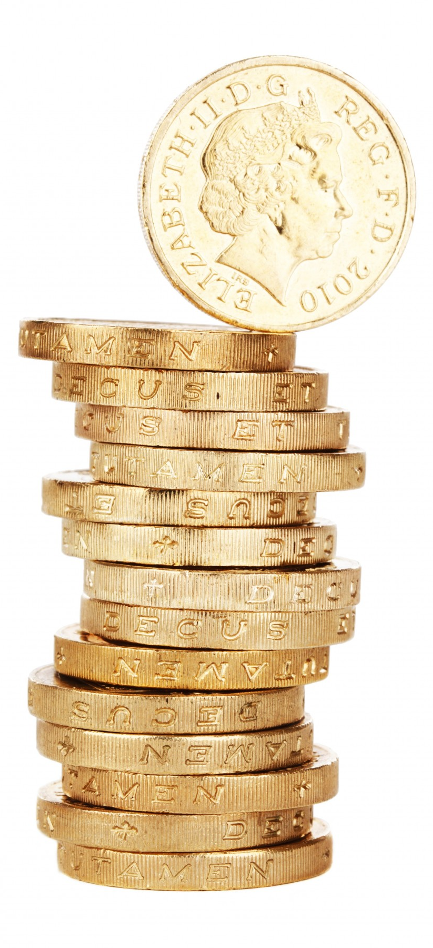
MY DEFINITION OF SUCCESS
A lot of luck.
Good timing.
Being in the right place.
Knowing how to recognize an opportunity.
Being ready when opportunity arrives.
Being smart enough to surround yourself with the right people and/or the right advice.

Slide 4
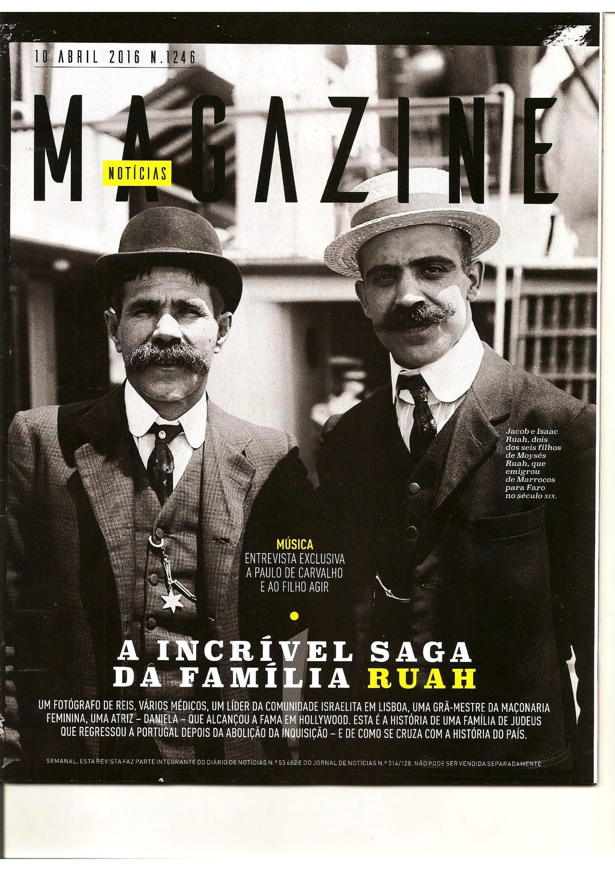
Successful entrepeneurs 100 years ago looked like this…

Slide 5
NOTHING
FAILS
LIKE
SUCCESS
Your business is more vulnerable when it is most successful.
…Or when it is still trying to prove itself.

Slide 6
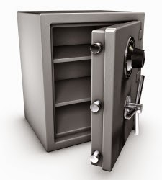
Why companies Fail
(CB Insights)
1- No market need
2- Ran out of cash
(Money and Time are finite.)
3- Not the right team
(Diverse team with diverse skills.)
4- Get outcompeted (Once you are in an interesting market, competitors will come. Ignore them at your risk.)
5- Pricing/Cost issues (High enough to be profitable, low enough to attract customers.)

Slide 7
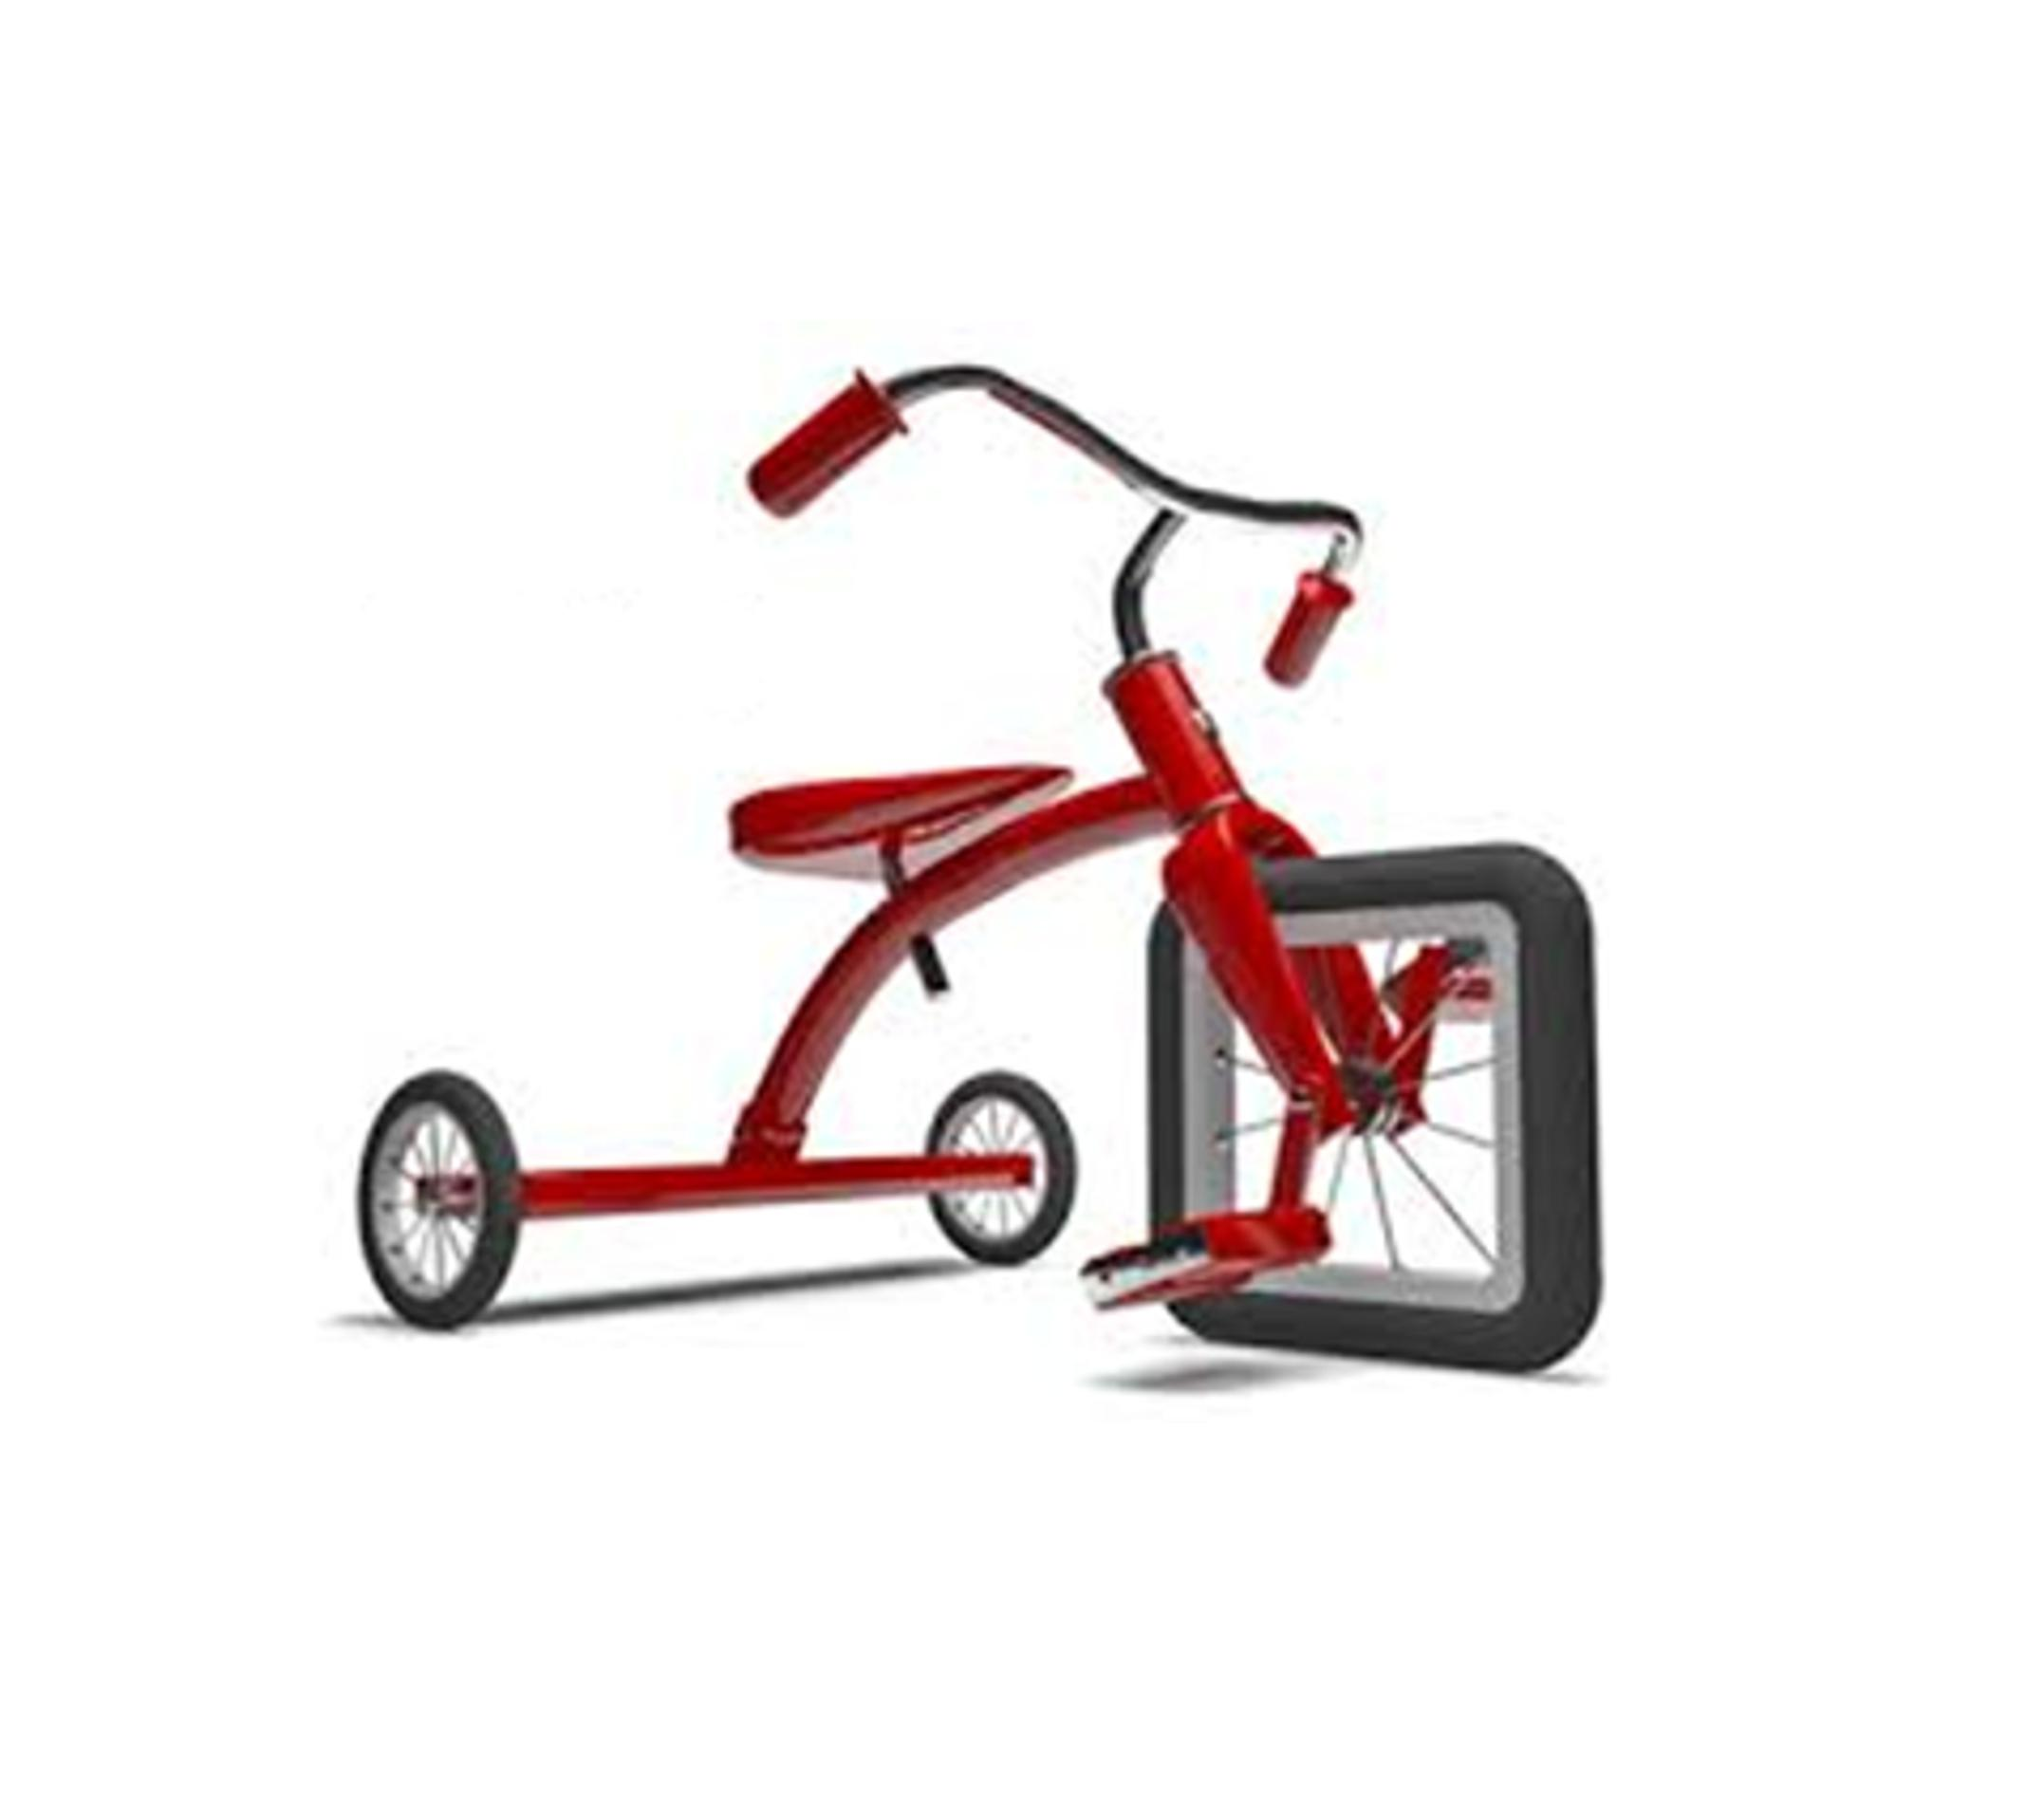
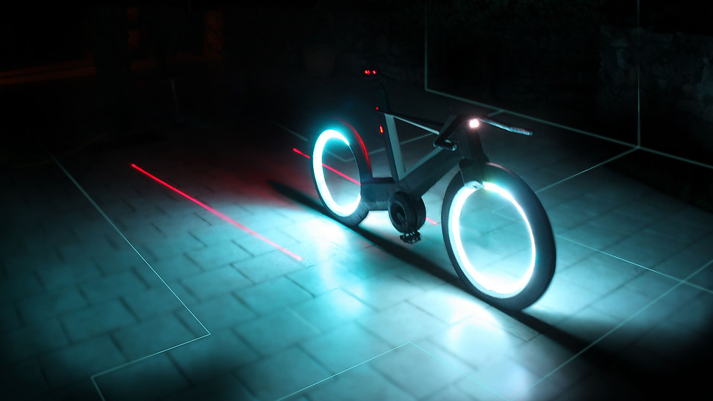
6-User un-friendly product (Bad things happen when you ignore what users want and need.)
Why companies Fail
(CB Insights)
7-Product without a business model
8-Poor marketing (Not Knowing your targeted audience or miss their attention.)
9-Ignore customers
Cyclotone

Slide 8
“Success is a lousy teacher. It seduces smart people into thinking they can’t lose.”
Bill Gates

Slide 9
NOTHING
FAILS
LIKE
SUCCESS
We ignore the warning signs.
We ignore the necessity for change and experimentation.
We assume we know all the answers and we do not listen.

Slide 10
Companies must never allow themselves to be seduced into focusing solely on maintaining the financial success of current business models.
The long term sustainability of a company is connected to its ability to maintain its market relevance.
THEN WE START UNDERESTIMATING THE RISKS…

Slide 11
Identify your RISKS
Founding Partners
Do partners get along
Product risks
Technical risks
Launch risks
Market acceptance risks
Revenue risks
Can you cover cost of sales?
Competition risks
Disruption risks
Political risks
Viral growth risks
Family companies and passing to the next generation

Slide 12
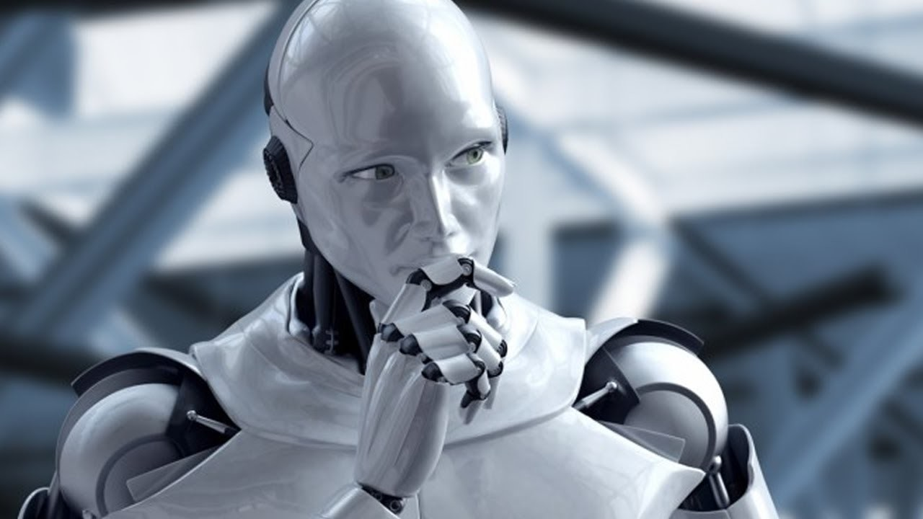
TECHNOLOGY
“Gradually, then Suddenly”
Disruptive trends in a given industry can rapidly accelerate.
Leaving the unprepared in the dust.
https://www.linkedin.com/pulse/os-empregos-do-futuro-fl%C3%A1vio-rocha

Slide 13
TECHNOLOGY
Technology expands our possibilities
We are no longer going to be treated like everybody else.
We are going to be treated individually.
(My DNA, My diet, My medicine, My publicity, My books, My ratings, My trips…)

Slide 14
Why these companies were unable to do some of this innovation during the good times when they were still profit making?
Do companies need a crisis before they start to respond to change?
sintrafesc.org.br

Slide 15
Do they need a near collapse before they start to innovate?
What is your methodology to respond to disruption?

Slide 16
HOW WE SEE THE WORLD
We don’t see things as they are.
We see things as we are.

Slide 17
Prior from modern times wealth came from:
Mining
Agriculture and Land
Industry
Oil
TODAY THE MAIN SOURCE OF
WEALTH IS KNOWLEDGE

Slide 18
TECHNOLOGY IS EATING EVERY INDUSTRY MARKET CAP – TOP 5 – TECH
2006 | 2011 | 2018
Exxon (446B) | Exxon (406B) | Apple (927B)
GE (383B) | Apple (376B) | Amazon (778B)
Total (327B) | Petro china (277B) | Alphabet (766B)
Microsoft (293B) | Shell (273B) | Microsoft (751B)
Citi (273B) | ICBC (228B) | Facebook (542B)

Slide 19
Fixed telephone 100 years
Electricity 60 years
Color TV 40 years
Microwave 25 years
Computer 22 years
Internet 15 years
Cellphones 15 years
Electrical car ?
Self driving car ?
Artificial intelligence ?
TECHNOLOGY ADOPTION IS QUICKER THAN EVER

Slide 20
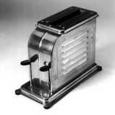
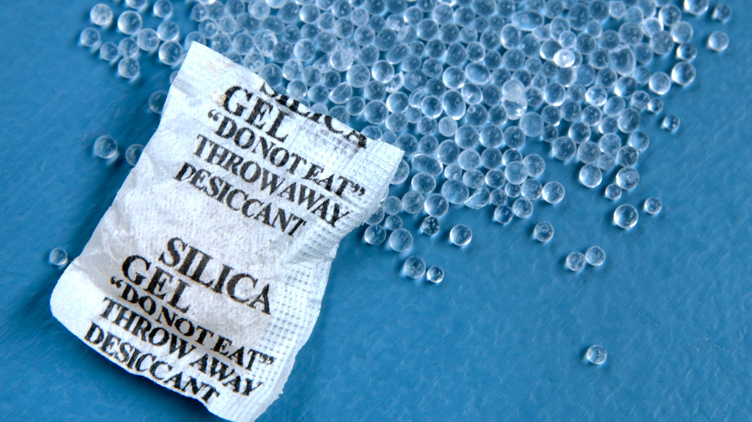
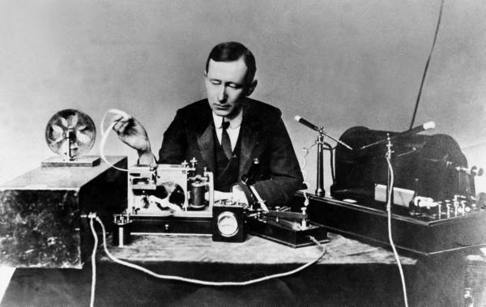
TECHNOLOGY 100 YEARS AGO
_ What were the main technological inventions on 1919?
Silica gel was invented to take humidity out of our packages.
Automatic pop up toaster.
Short-wave radio was invented.
https://g3timeline.wordpress.com/monika/inventions-1911-1921/
WE HAVE MORE INVENTIONS PER HOUR TODAY THAT 1919 HAD ALL YEAR.

Slide 21
MINDSET
A- Attitude
B- Beliefs
C- Choice
“No matter the circumstances you always control your attitude, and your beliefs and the choices you make”.
Alison Botha, South Africa

Slide 22
BRAIN
How can so many people be so wrong about so much?
Illusions don’t happen in our eyes, they happen in our brains
Our brains often jump into conclusions without much thinking.
The brain is a product of millions of years of evolution.

Slide 23
Advertisement
Sorry what you know is no longer true.
Please return your brain for a free upgrade.
Designcomcafe.com

Slide 24
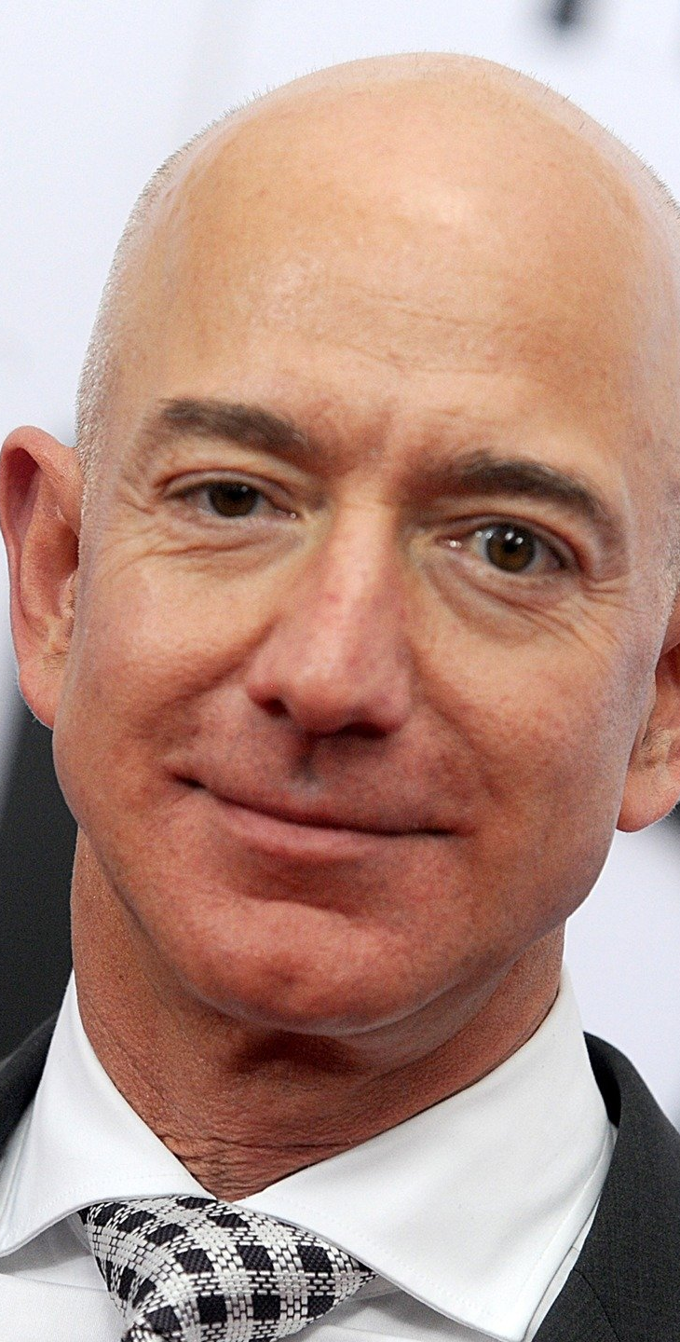
Jeff Bezos about Customers
“I constantly remind our employees to be afraid and wake up every morning terrified .
Not of our competition, but about our customers.
Our customers are the ones that made our business what it is. The one’s we have a relationship and an obligation to.
And they will be loyal to us until someone else offers them a better service.”

Slide 25
Consumers are more demanding
Faster
More productive
More connected
More convenient
More personalized
Their patience is slimmer
Expectations are higher
They do not tolerate mistakes anymore

Slide 26
Tech Era
The tech era has taught people to expect constant innovation.
When companies fall behind, consumers are quick to punish them.
case

Slide 27
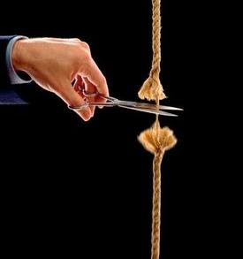
DISRUPTION
It is highly likely that your business will be disrupted. Make sure you are the one creating the disruption.
Start thinking about innovations in your own business.

Slide 28
Past success does not guarantee future success
Your competition adapts, your customer expectation changes, and technology changes the game.

Slide 29
THE FUTURE
The BEST way to predict the FUTURE is to create it
YOURSELF.

Slide 30
WHAT YOU CAN DO
Listen to your customers
Surround yourself with the right people
Ask the right questions
Question your beliefs
Name a non-operational advisory board to
look at your Company with outside eyes.
Create an innovation environment in your company to experiment new things.
If you do same things again and again you may be at a high risk of disruption.
Look for the next wave of technology.
Anticipate the future.

Slide 31
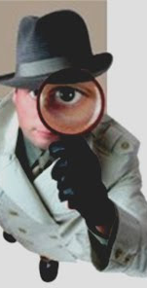
HOW I RECOGNIZE AN OPPORTUNITY TO INVEST
Market relevance
Addressing a Potential Sizeable market
Repeatability
Profitability
Scalability
Great People
Something unique that can be further developed or expanded.
When I think i can anticipate the future.

Slide 32
NOTHING
FAILS
LIKE
SUCCESS
Thank you!
Eduardo Ruah
Entrepeneur, Advisory Board Member
eduardo.ruah@gmail.com
Mobile /WhatsApp:
+351 933440068

